Slide 1
Permanent Visa Application Certification in the United States
Group 6
Jack CRUM

Slide 2
Reasons for denial
Poor health
Criminal records
Security threat
Become a public charge
Work can be done by an American
Illegal immigrant or immigration violator
Missing required documents
Ineligible for citizenship/draft evader
Previously removed
Miscellaneous

Slide 3
Dataset
The data covers 2012-2017
374,362 applications and 161 variables
Variables include information on employer, position, offered wage, job posting history, employee education and past visa history, associated lawyers, and final decision.
Case status (certified or denied) is the predicted variable
33,669,345 missing values
Final dataset included 202,203 observations and 14 variables or 323 dummy variables

Slide 4
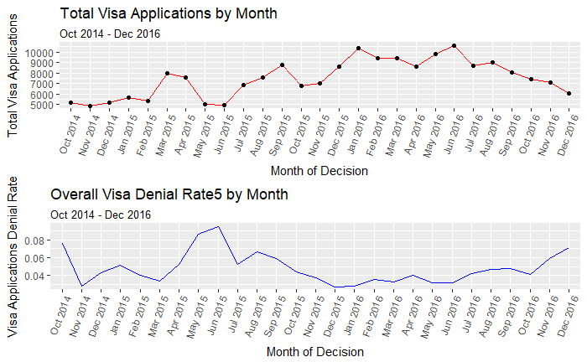
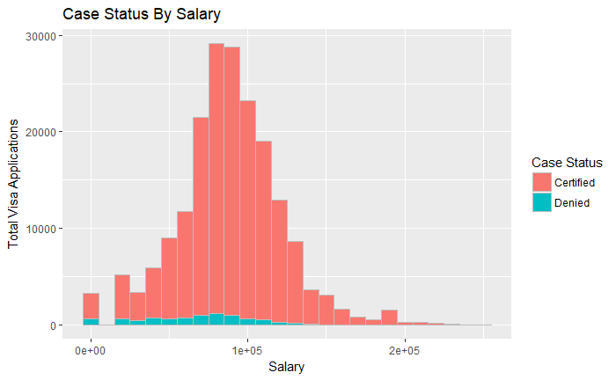
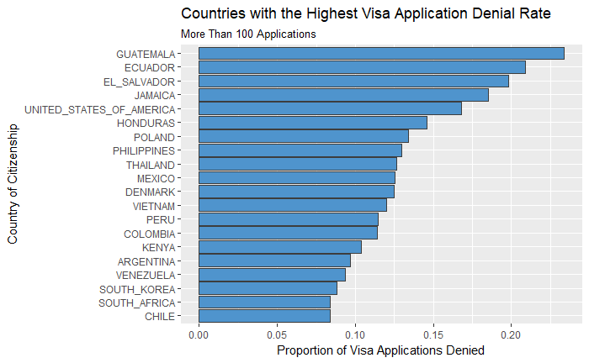
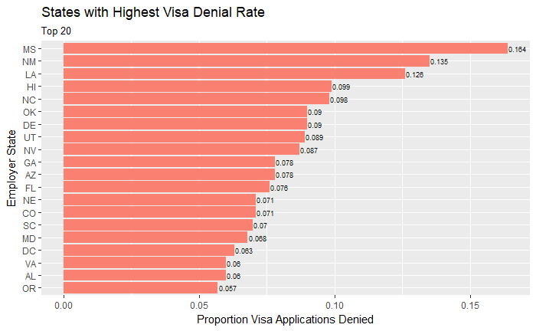

Slide 5
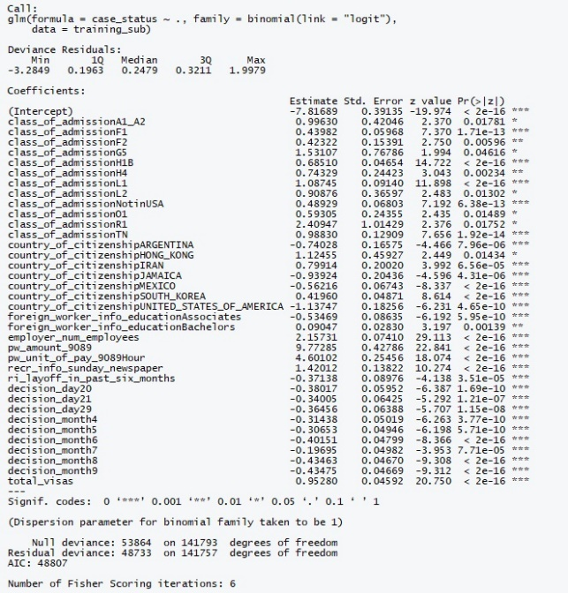
Logistic Regression: Significant variables

Slide 6
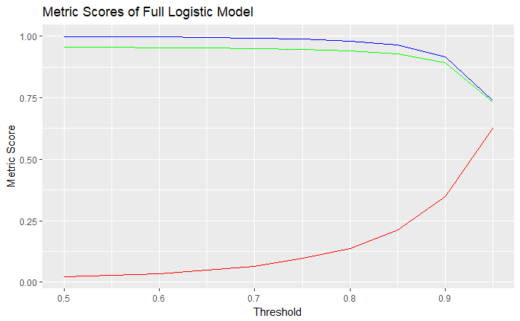
Logistic Regression
Accuracy
Sensitivity
Specificity

Slide 7
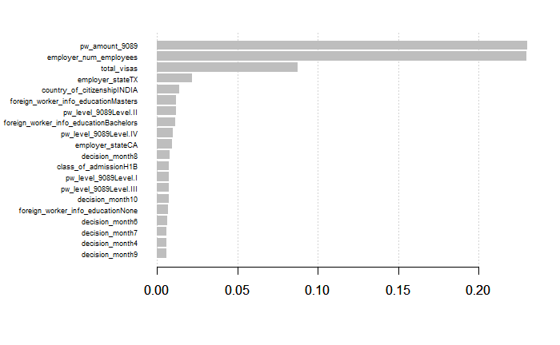
XGBoost model

Slide 8
Frequentist model scores
Model | Accuracy | Sensitivity | Specificity | Pos Pred Value | Neg Pred Value
Full Logistic | 0.9315 | 0.9655 | 0.2246 | 0.9629 | 0.2378
Subset Logistic | 0.8987 | 0.9280 | 0.2860 | 0.9644 | 0.1602
Stepwise Logistic | 0.9362 | 0.9735 | 0.1594 | 0.9602 | 0.2240
XGBoost2 | 0.9316 | 0.9566 | 0.4117 | 0.9713 | 0.3127
XGBoost1 | 0.9527 | 0.9831 | 0.3175 | 0.9678 | 0.4748

Slide 9
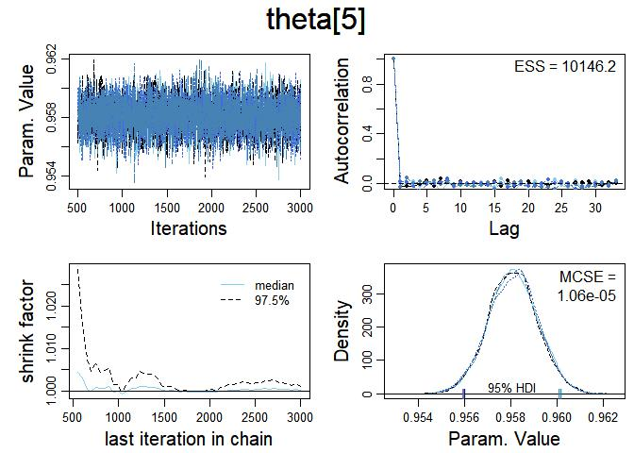
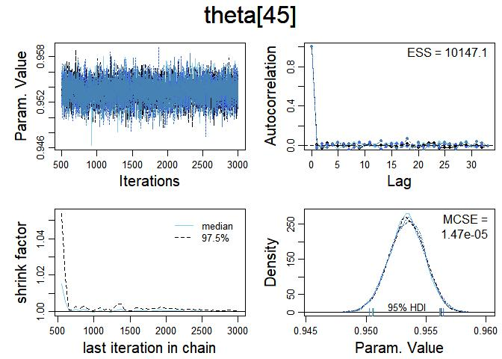
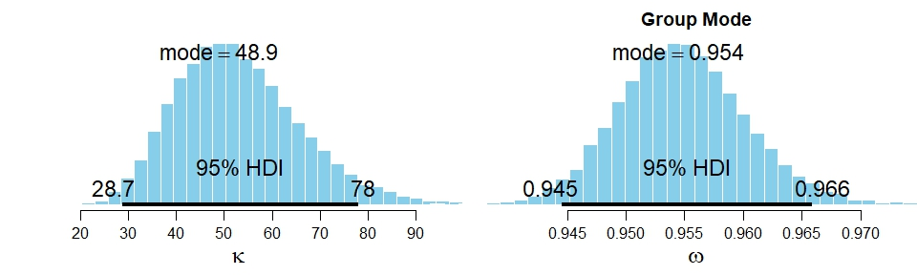
Employer state
California
Texas

Slide 10
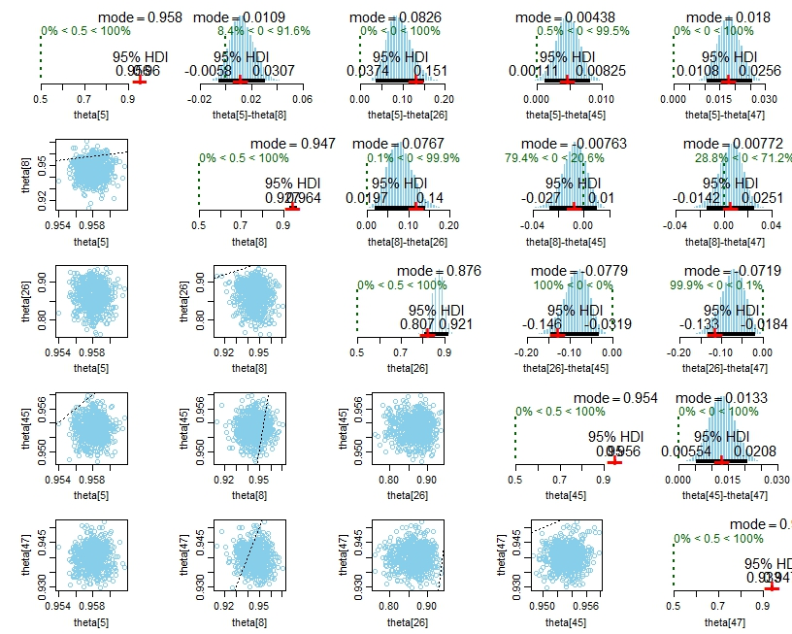
Employer State
5 – California
8 – DC
26 – Mississippi
45 – Texas
47 – Virginia

Slide 11
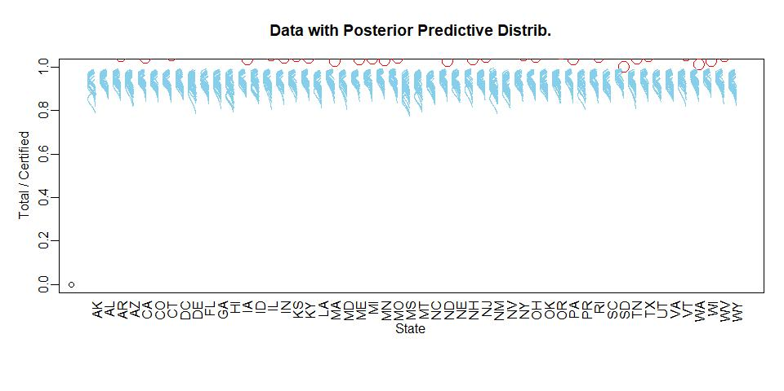

Slide 12
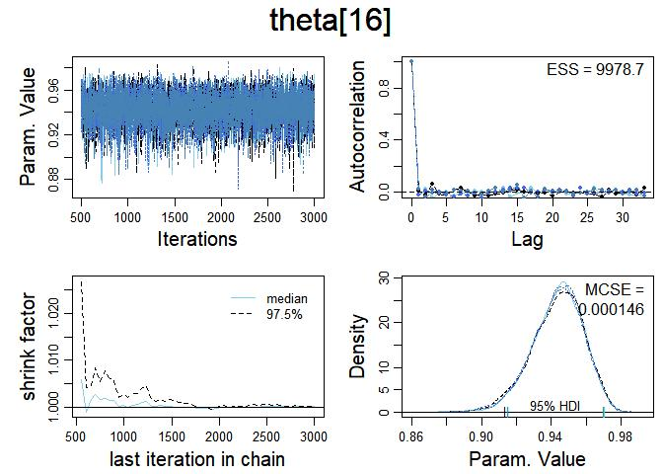
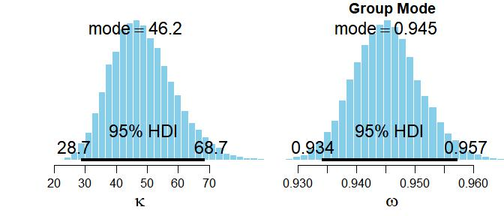
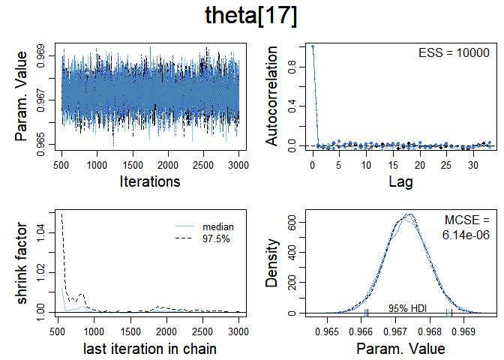
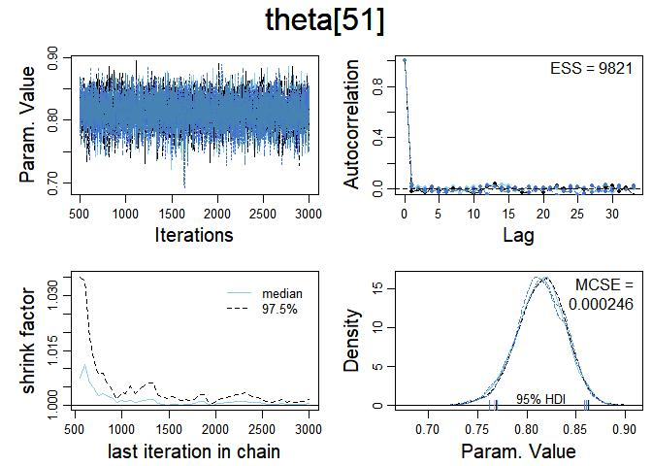
Country of Citizenship
Hong Kong
Inida
United States

Slide 13
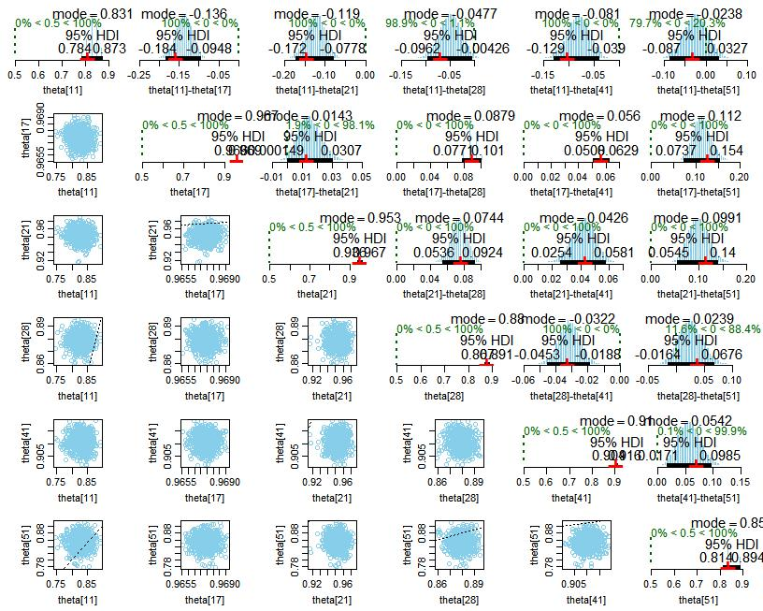
Country of citizenship
11 – Ecuador
17 – India
21 – Israel
28 – Mexico
41 – South Korea
51 – United States of America

Slide 14
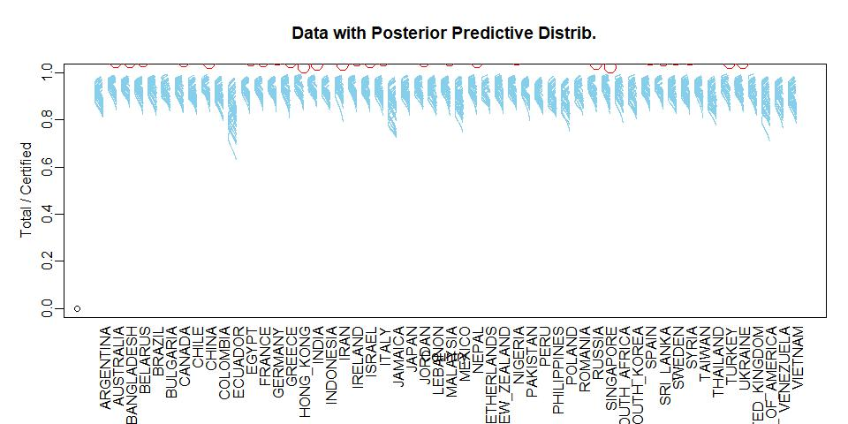

Slide 15
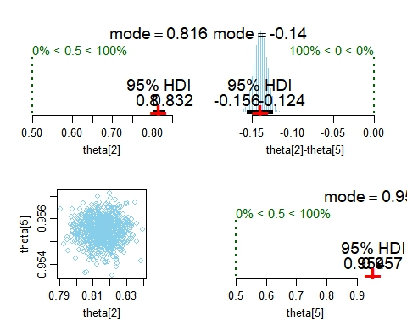
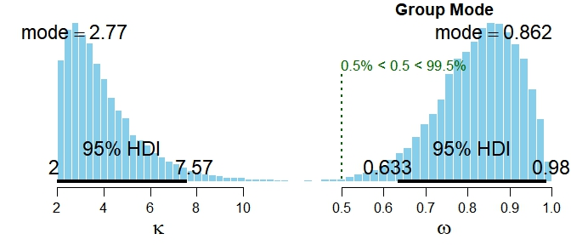
Unit of pay: Yearly Salary VS Hourly Wage

Slide 16

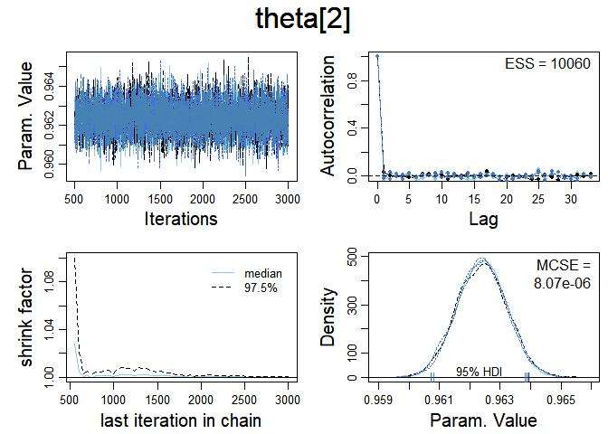

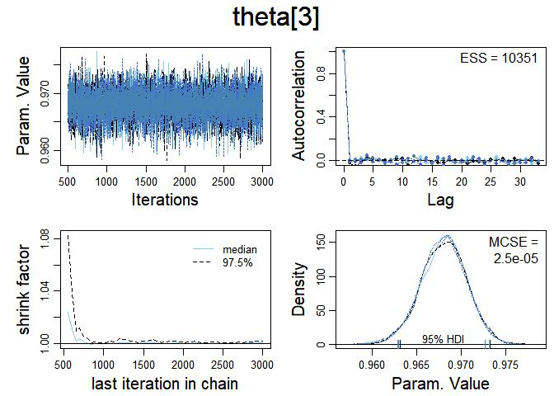
Associate's
Bachelor’s
None
Doctorate

Slide 17
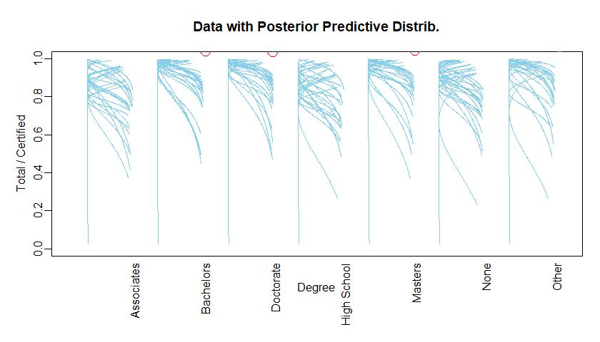

Slide 18
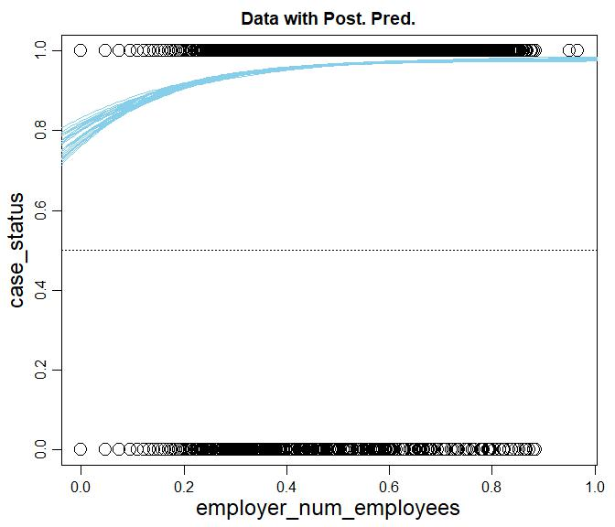
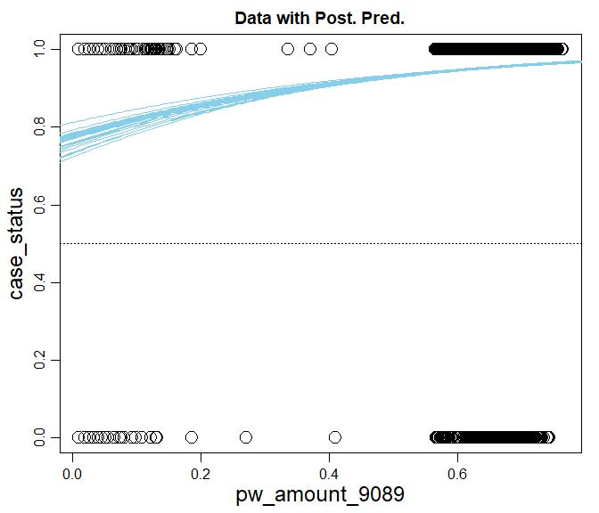
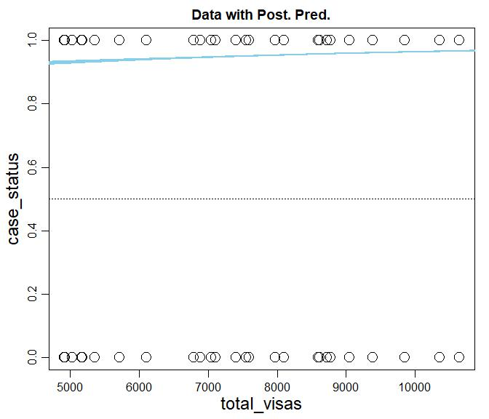
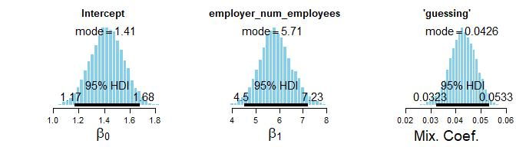
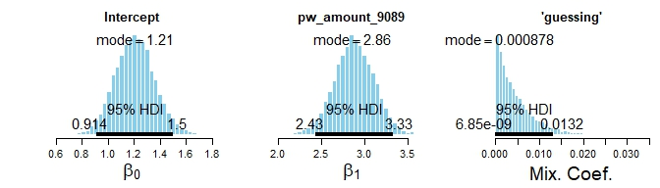
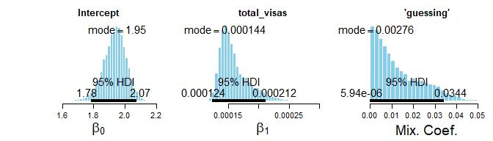

Slide 19
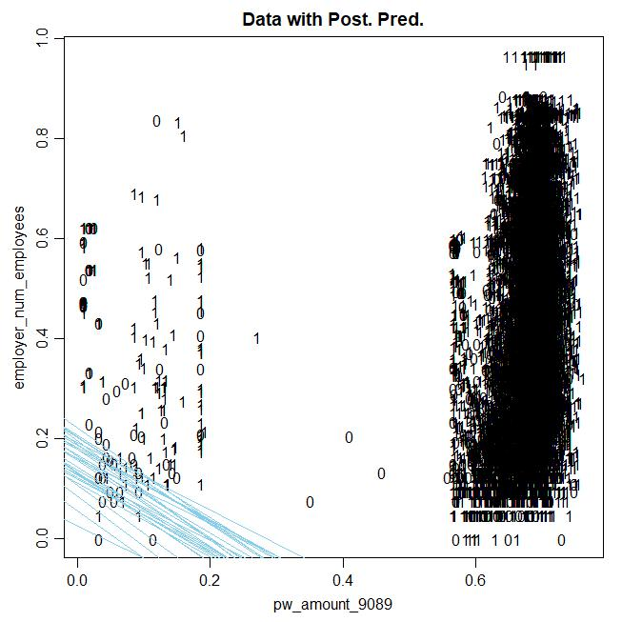
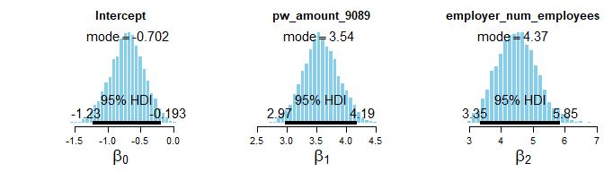

Slide 20
Conclusions
Smaller companies have lower rate than bigger companies
Yearly salary has higher rate than hourly wage
Bachelor’s and higher have higher rate and Associate’s and lower have lower rate
Ecuador, Mexico, Jamaica, Thailand, and the United States citizens have a statistically probable lower rate of certification than the group.
Mississippi, Hawaii, and Louisiana have a statistically probable lower rate of certification than the group
Total visas in the month of decision doesn’t matter

